Slide 1
Accelerating metadynamics by adversarial attacks on biasing potential
Project 3.320
09.12.2021
Swagata Roy
Julia Orlova

Slide 2
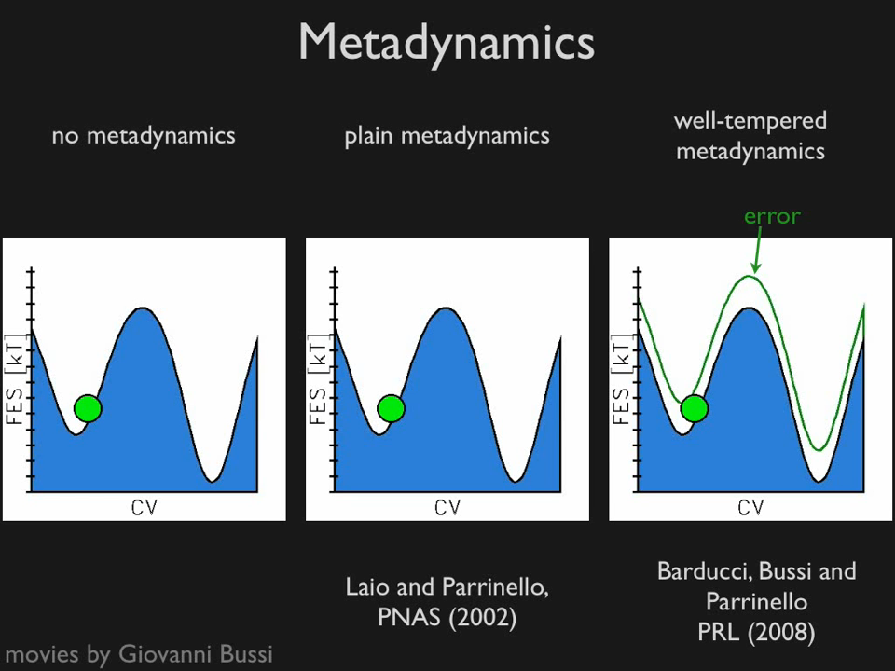
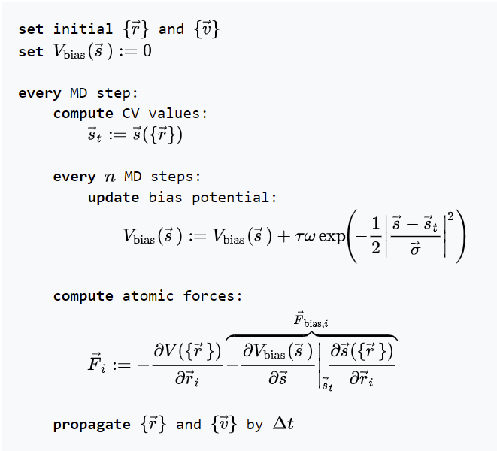
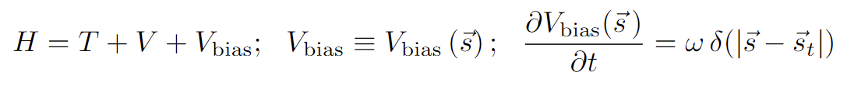
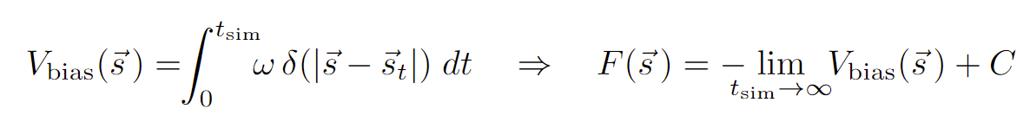
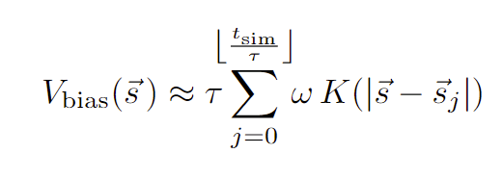
Metadynamics
https://sites.google.com/site/giovannibussi/gallery#TOC-Metadynamics
A. Laio and M. Parrinello, "Escaping free-​energy minima."Proceedings of the National Academy of Sciences99.20 (2002): 12562-​12566.call_made

Slide 3
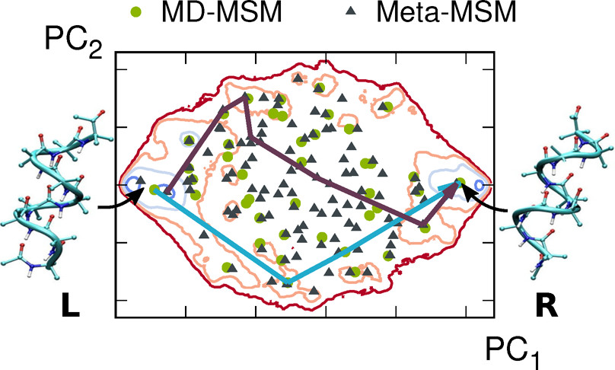
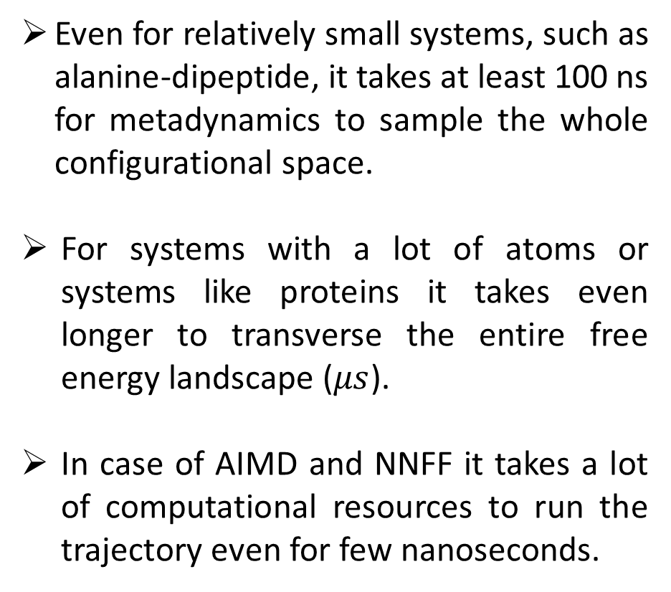
Why do we need to enhance metadynamics?
Even for relatively small systems, such as alanine-dipeptide, it takes at least 100 ns for metadynamics to sample the whole configurational space.
For systems with a lot of atoms or systems like proteins it takes even longer to transverse the entire free energy landscape ($μs$).
In case of AIMD and NNFF it takes a lot of computational resources to run the trajectory even for few nanoseconds.
J. Phys. Chem. B 2018, 122, 21, 5508–5514

Slide 4
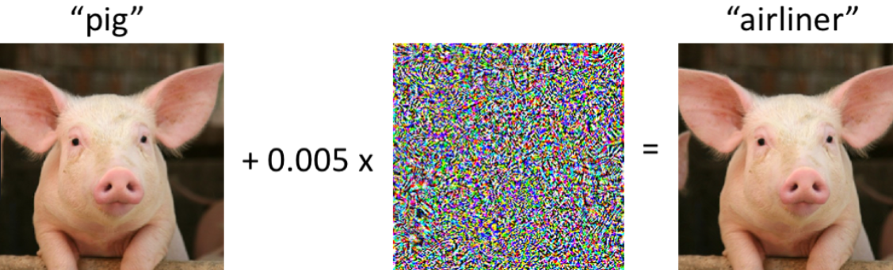
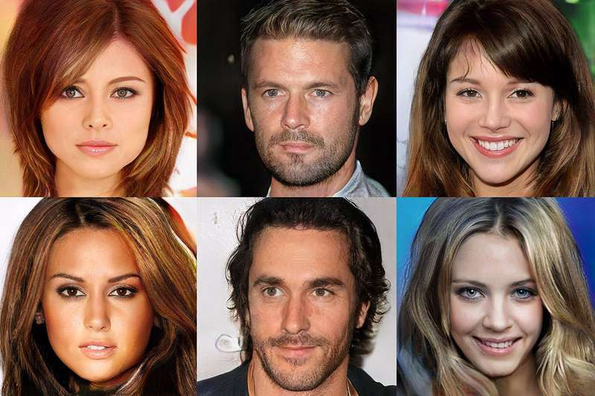
Adversarial attacks on neural networks
Adversarial attacks are meant to fool a neural network, be it classifier or regressor. The smallest addition of noise that will not be comprehensible in human eyes can make the neural network wrong. Adversarial attacks are mostly harmful threats to an existing ML model, but they can be used wisely as well.
Generative Adversarial attack (GAN) uses it to design new structures, art or even fake celebrity pictures. It consists of a generative network that maps from latent space to a distribution of data and its objective is to increase error of discriminative network that classifies real from fake.

Slide 5
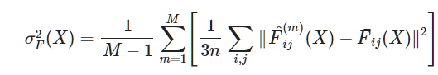
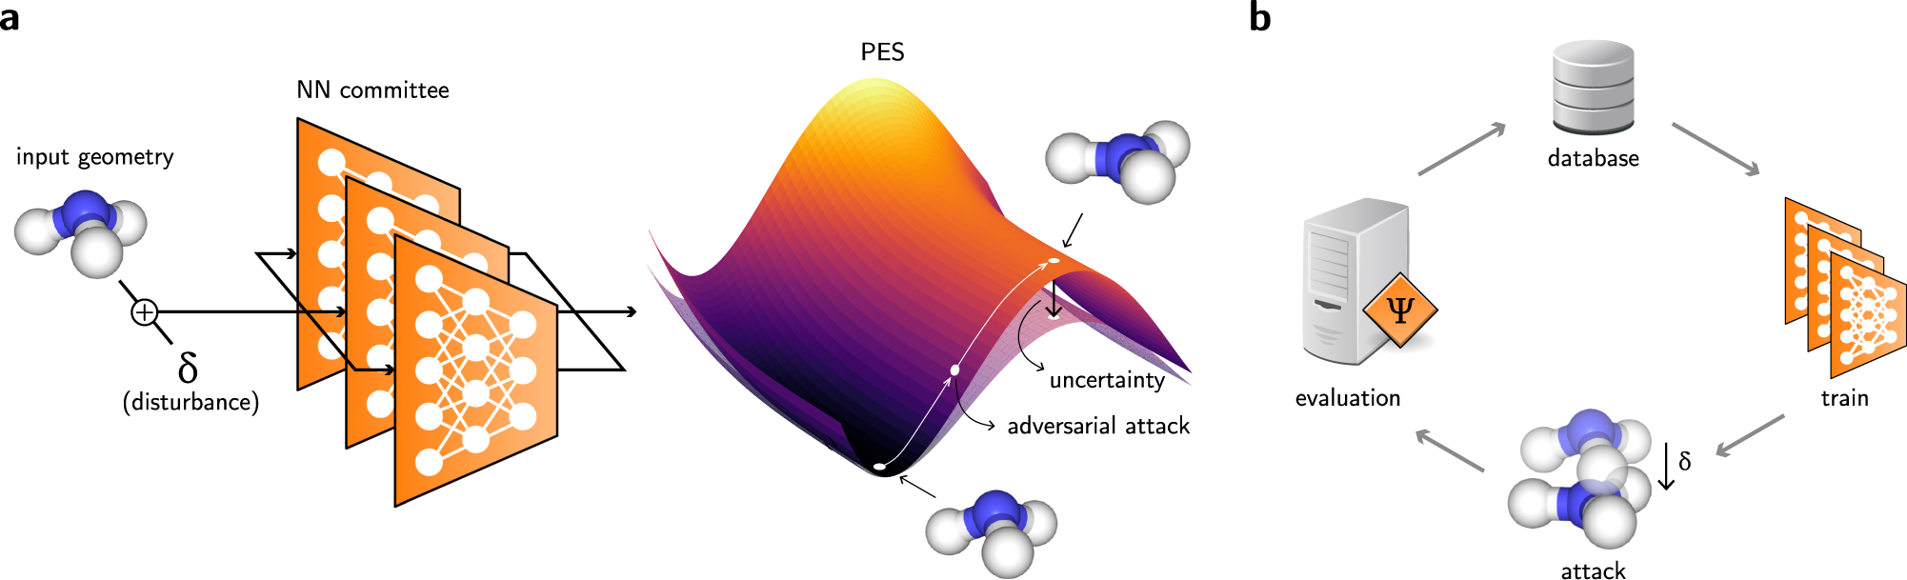
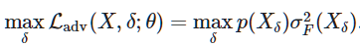
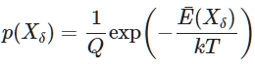
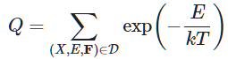
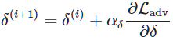
Adversarial attack to improve Neural Force fields
Neural Network inter-atomic potentials are currently very reliable, being able to predict with DFT accuracy but also lot faster. However, they are highly restricted to training data region. Adversarial attack has been recently used to sample geometry that NFF is highly uncertain about. These frames may have been achieved alternatively by molecular dynamics but they take up a lot of time. These adversarial attacks can obtain highly uncertain frames quite fast and then they can be put back in training data for active learning of the ml model.
Ref: D. Schwalbe-Koda, A. R. Tan, and R. Gómez-Bombarelli, Differentiable Sampling of Molecular Geometries with Uncertainty-Based Adversarial Attacks, Nat. Commun. In press (2021).

Slide 6
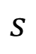
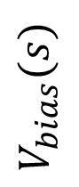
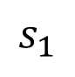
Accelerating metadynamics…
Trajectory 1.
Trajectory 2.
Trajectory 3.
$$V_{bias}(s)$$
$$s$$
$$s_{1}$$

Slide 7
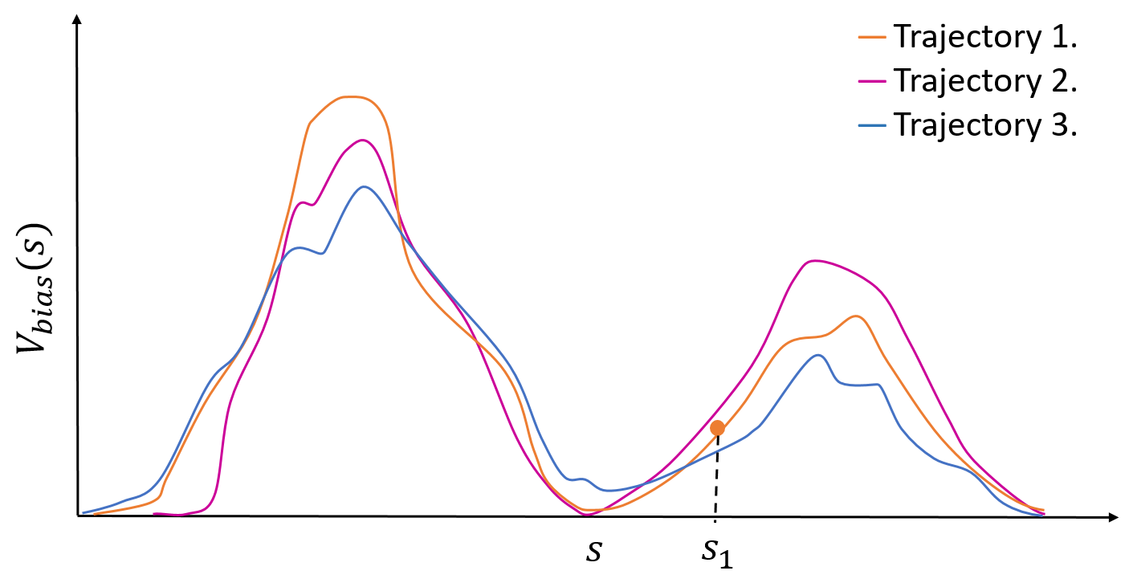
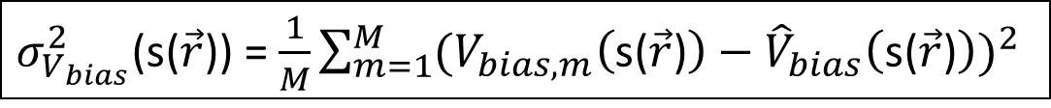
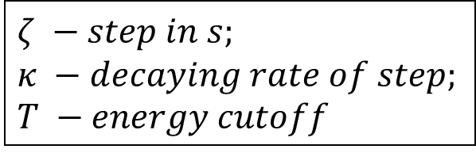
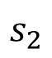
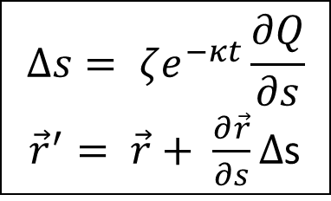
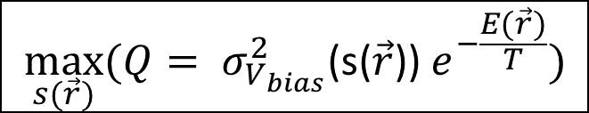
Accelerating metadynamics…
$σ_{V_{bias}}^{2}$(s($\vec{r}$)) = $\frac{1}{M}\sum_{m=1}^{M}{{(V_{bias,m}\left(\text{s}\text{(}\vec{r}\text{)}\right)−{\hat{V}}_{bias}\left(\text{s}\text{(}\vec{r}\text{)}\right))}^{2}}$
$$\max_{s(\vec{r})}{{(Q= σ}_{V_{bias}}^{2}\text{(}\text{s}\text{(}\vec{r}\text{))} e^{−\frac{E(\vec{r})}{T}})⁡}$$
$$∆s= ζe^{−κt}\frac{∂Q}{∂s}$$
${\vec{r}}^{′}= \vec{r}+ \frac{∂\vec{r}}{∂s}∆$s
Adversarial attack
$$ζ −step in s;$$
$$κ −decaying rate of step;$$
$$T −energy cutoff$$
$$s_{2}$$

Slide 8
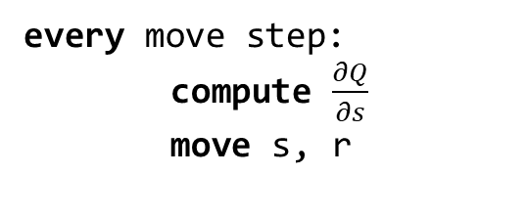
The Algorithm
every move step:
compute $\frac{∂Q}{∂s}$
move s, r

Slide 9
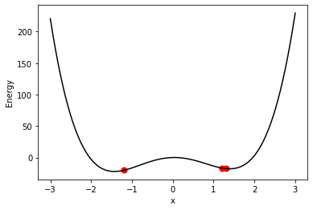
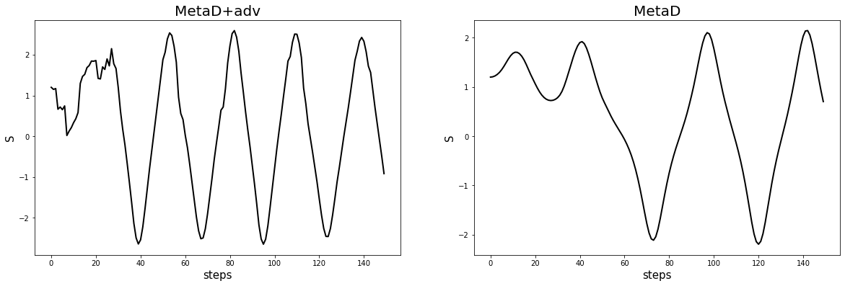
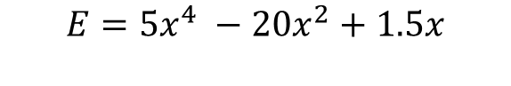
1D potential well
For 1D double well, we start with three NVE trajectories with different initial position and velocities. Arbitrary units are chosen but to compare everything is same between metadynamics and adversarial attack
$$E=5x^{4} −20x^{2}+1.5x$$
With adversarial attack, the bias potential became diffusive much earlier and thus we can sample faster and converge to free energy faster than actual metadynamics.

Slide 10
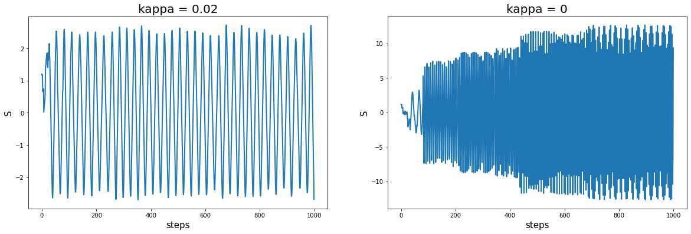
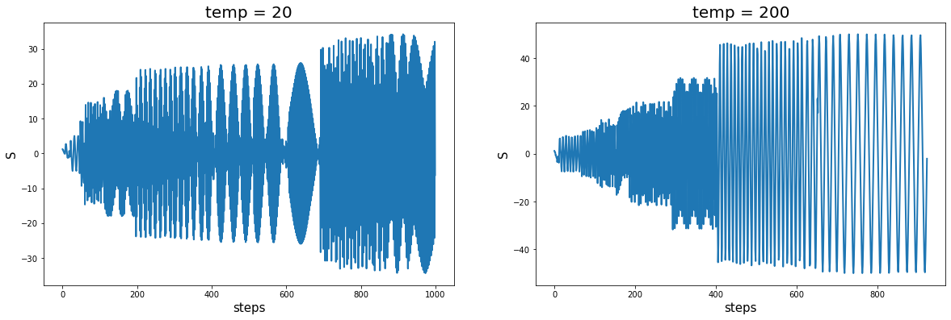
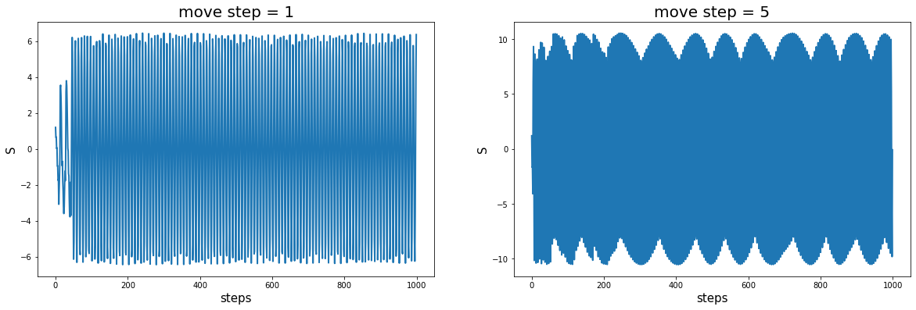
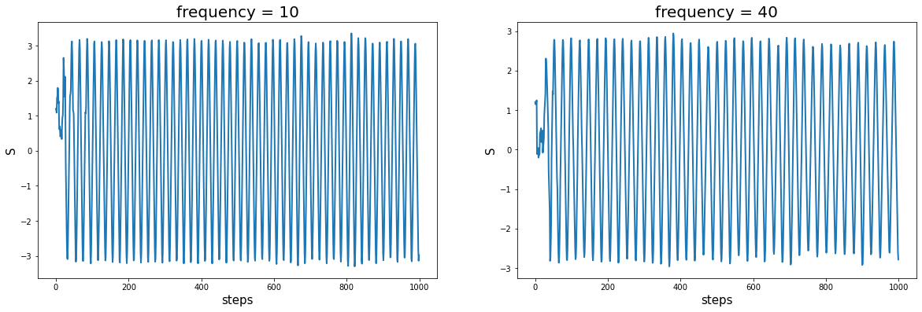
Hyperparameter sweep
With increasing kappa, we decreases the effect of drifting off to high uncertain area after certain time. Similarly with decreasing temp, we reduces exploration. With step size obviously, we venture more. Increasing the frequency of occurrence of movement, brings it closer to actual metadynamics

Slide 11
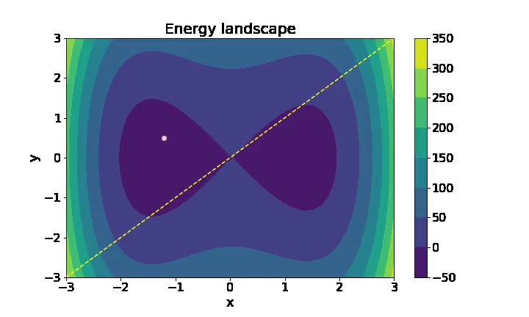
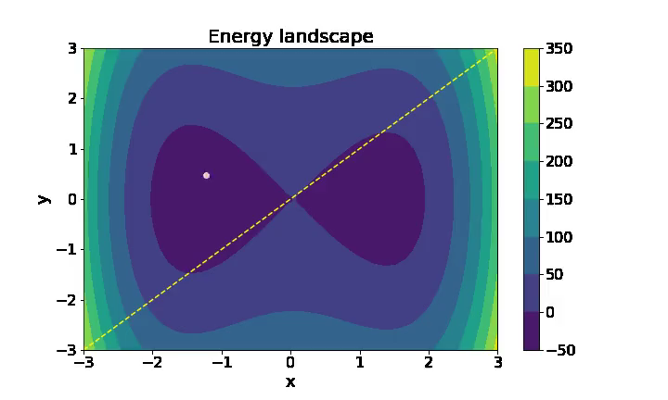
2D Potential well
MetaD
MetaD + Adv
For any CV we give, adversarial attacks help us to achieve uniformity along the CV-direction much faster than metadynamics.
Even for a ‘bad’ CV…

Slide 12
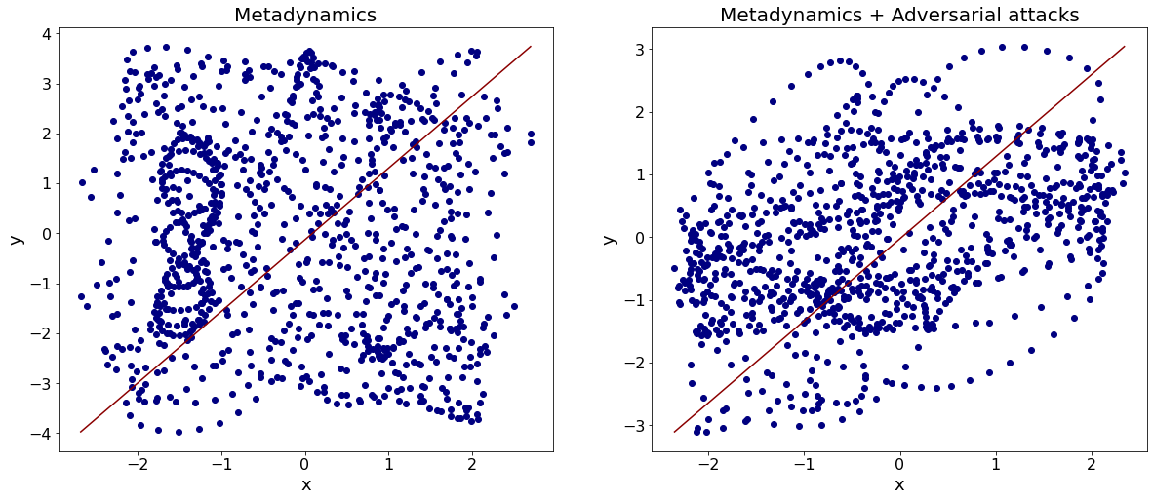
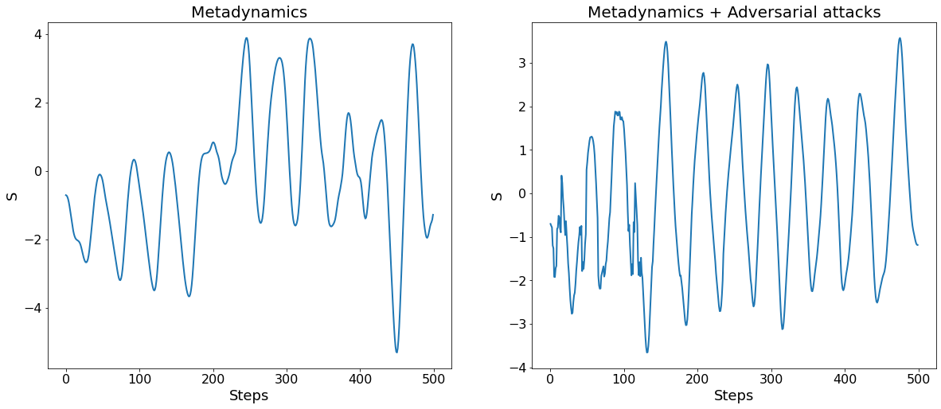
As we mentioned before, the adversarial attacks ‘guide’ us in the CV-direction, while with metadynamics we have more disperse trajectory.
Adversarial attacks, thus, help us to achieve the diffusive behavior in CV-direction much faster.

Slide 13
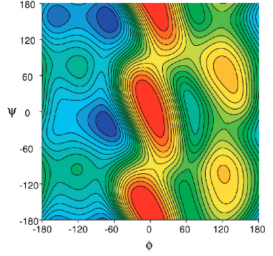
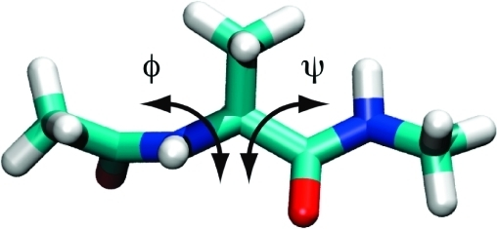
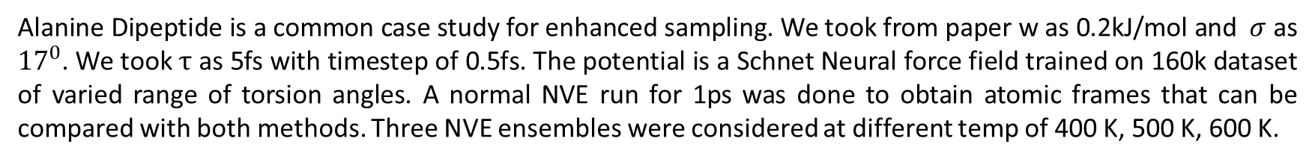
Alanine Dipeptide
Alanine Dipeptide is a common case study for enhanced sampling. We took from paper w as 0.2kJ/mol and $σ$ as ${17}^{0}$. We took $τ$ as 5fs with timestep of 0.5fs. The potential is a Schnet Neural force field trained on 160k dataset of varied range of torsion angles. A normal NVE run for 1ps was done to obtain atomic frames that can be compared with both methods. Three NVE ensembles were considered at different temp of 400 K, 500 K, 600 K.
J. Phys. Chem. B 2010, 114, 16, 5632–5642

Slide 14
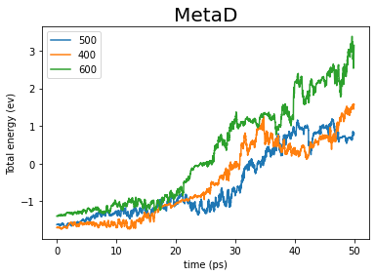
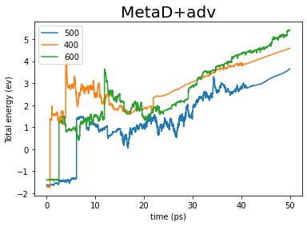
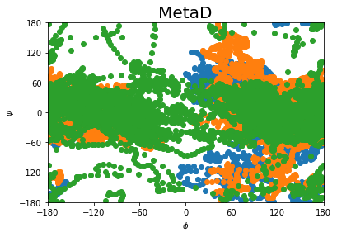
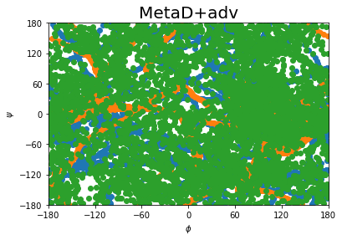
Each of the simulations were run for 50ps which is time consuming for NNFF. In one case, only metadynamics is used whereas in another adversarial attack is performed with a particular set of hyperparameters
Preliminary jumps in adversarial attack helps to get out of local regions and thus sample faster and more space in 50ps

Slide 15
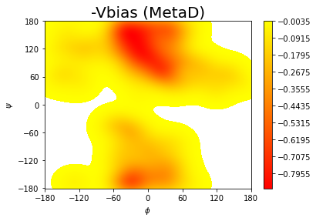
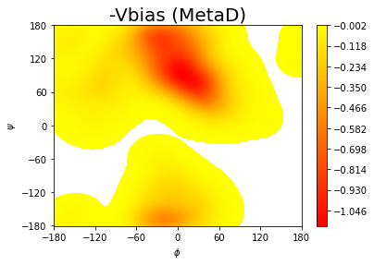
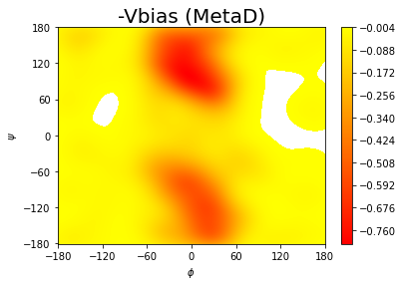
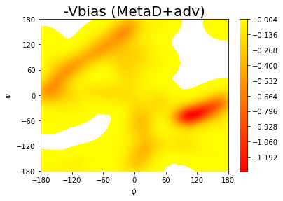
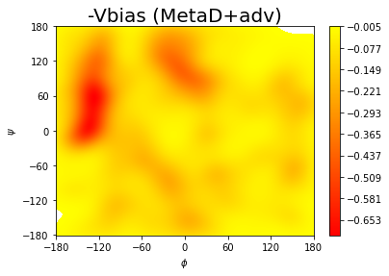
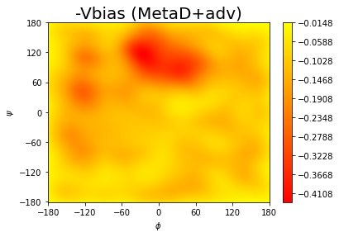
The –Vbias(s) which should be equal to free energy after it converges is plotted. In our case, we could not converge it but, we have good coverage of space and also likely regions more than normal metadynamics
J. Phys. Chem. B 2010, 114, 16, 5632–5642

Slide 16
Summary
Adversarial attacks along with metadynamics has an edge over normal metadynamics .
It gets to diffusive region in collective variable much faster and thus can contribute to faster convergence of free energy surface.
The hyper parameters perform intuitively and thus can be implemented by user’s discretion easily.
Moving from toy models, the method even works for molecular system like alanine dipeptide. It traverses more collective variable space than in normal metadynamics.
Since the adversarial attack serves as an extra push in the direction of change of collective variable, it achieves faster diffusion, which for any cv good or bad can lead to faster convergence. Therefore, we still need a good collective variable for sampling.

Slide 17
Future work
Perform tests with well-tempered metadynamics.
Perform the similar tests in NVT ensemble.
Perform longer trajectories to check the convergence of the bias potential and compare the rate. We can use classical force fields to speed up our sampling.
Perform the tests on more complex systems, for example, proteins, where this method can significantly reduce time.

Slide 18
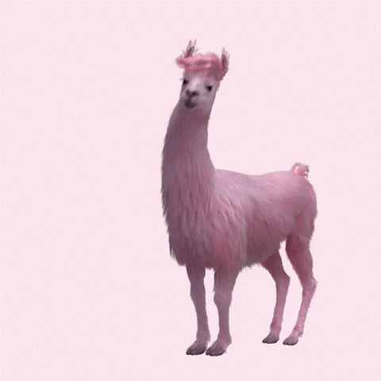

Thank you!

